Slide 1
Titles & Works CIted

Slide 2
Works Cited MLA Format
Works Cited Section
Print “Works Cited” at end of paper
Alphabetize listed works by last name
If single entry exceeds one line, indent the second line
Basic MLA Book Format(s)
Last, First MI. Title in Italics. Publisher, Date.
Last, First. Title in Italics. Edited by First Last, Publisher, Date.
Last, First MI, editor. Title in Italics. Translated by First Last, Publisher, Date.
Last, First. Title in Italics. Translated by First Last, edited by First Last, Publisher, Date.

Slide 3
Works Cited MLA Format
Basic MLA Book Format(s)
Last, First MI. Title in Italics. Publisher, Date.
Last, First. Title in Italics. Edited by First Last, Publisher, Date.
Last, First MI, editor. Title in Italics. Translated by First Last, Publisher, Date.
Last, First. Title in Italics. Translated by First Last, edited by First Last, Publisher, Date.
Benjamin of Tudela
Author: Benjamin [of Tudela]
Editor: Michael A. Signer
Translator: Marcus N. Adler
Publisher: Pangloss Press
Date: 1983

Slide 4
Titles Making a good first impression
What does a good title look like?
Specific and inviting
Announces paper topic
Gestures toward the complexity of the argument
Raises the reader’s curiosity

Slide 5
Titles Making a good first impression
What to avoid?
Uninformative
“A New Reading of Gerald of Wales’ Topography of Ireland”
Overdone jokes/puns, “edgy”

Slide 6
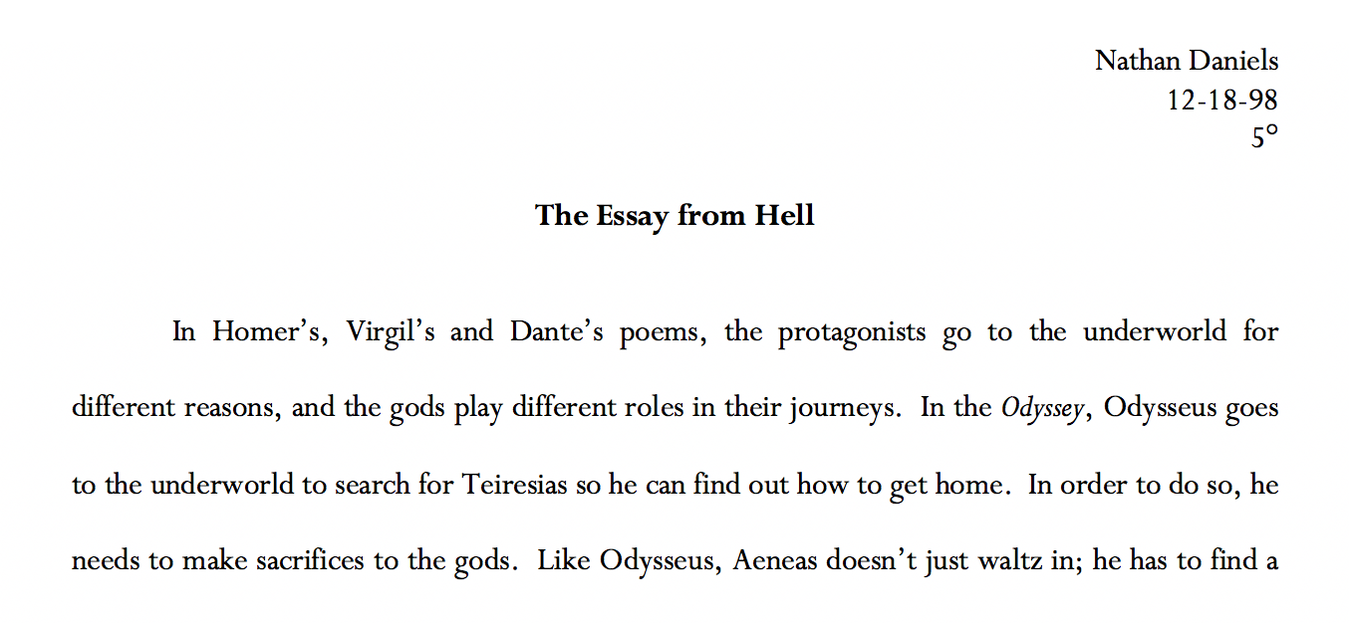
Titles Making a good first impression (!)

Slide 7
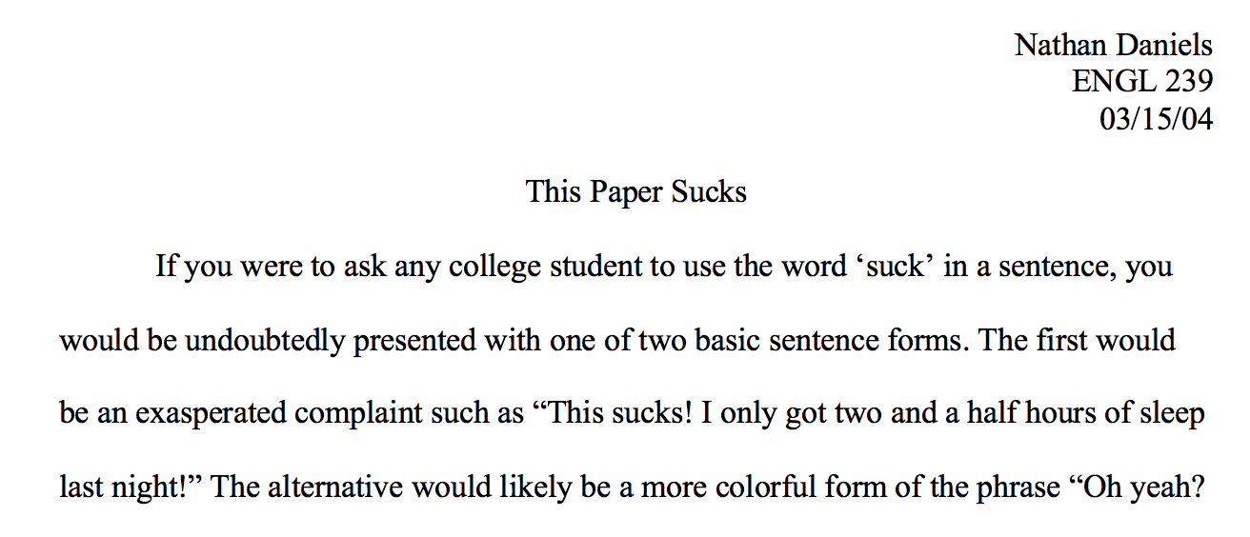
Titles Making a good first impression (!)

Slide 8
Titles Making a good first impression
What to avoid?
Uninformative
“A New Reading of Gerald of Wales’ Topography of Ireland”
Overdone jokes/puns, “edgy”
Clichés
“To Wait or Not to Wait: Two Approaches to Exile in Benjamin of Tudela”
Grandiose / Incomprehensible
“Towards a New Hermeneutics of Medieval Jewish Eschatology: Re-Interpreting Messianism and David Alroy in Benjamin of Tudela’s Itinerary”
Forgetting to change your placeholder title…
“Title, When I think of It, Goes Here”

Slide 9
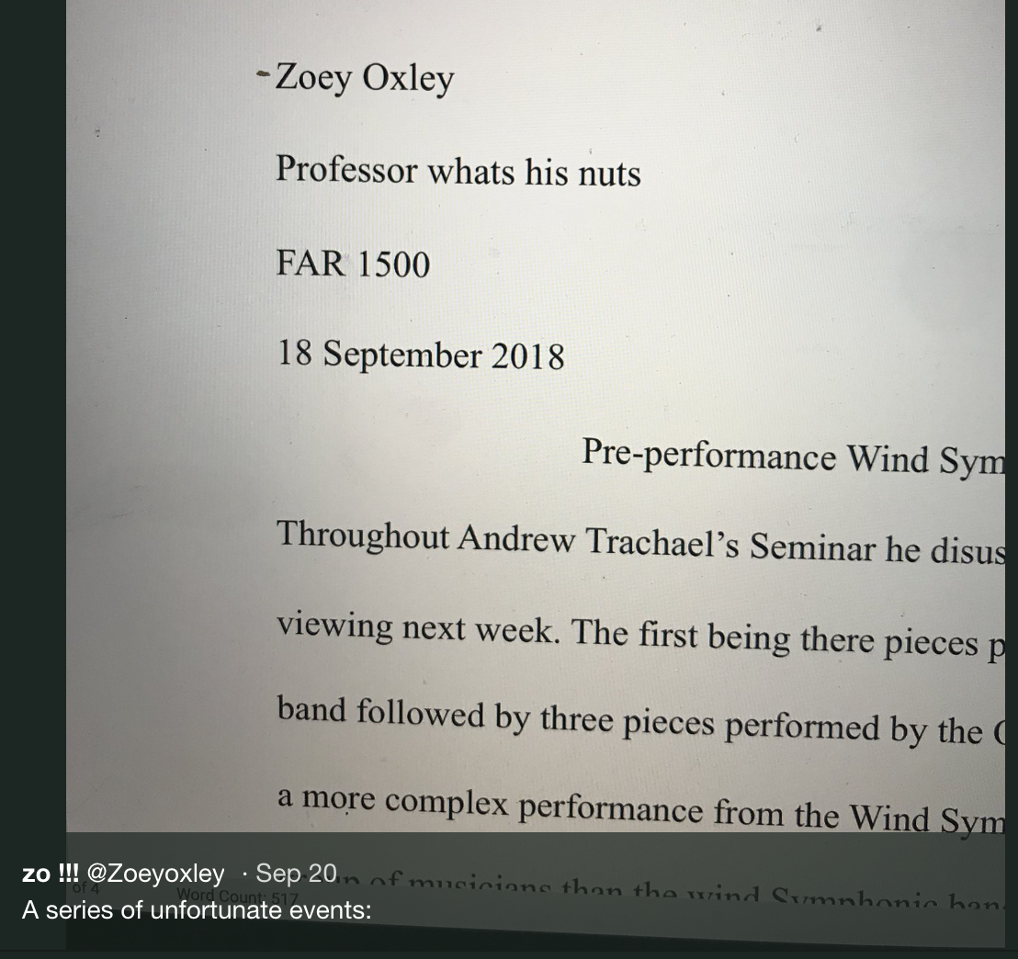
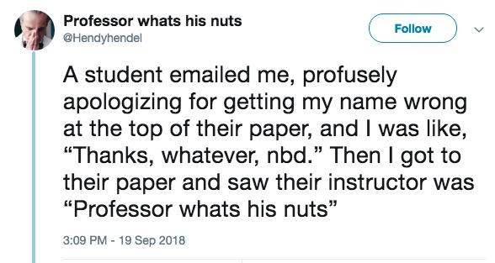
Titles Making a good first impression

Slide 10
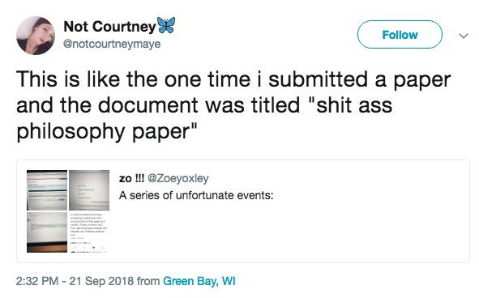
Titles Making a good first impression

Slide 11
Titles Making a good first impression
What to avoid?
Uninformative
“A New Reading of Gerald of Wales’ Topography of Ireland”
Overdone jokes/puns, “edgy”
Clichés
“To Wait or Not to Wait: Two Approaches to Exile in Benjamin of Tudela”
Grandiose / Incomprehensible
“Towards a New Hermeneutics of Medieval Jewish Eschatology: Re-Reading David Alroy in Benjamin of Tudela’s Itinerary”
Forgetting to change your placeholder title…
“Title, When I think of It, Goes Here”
Or, the title from the previous assignment

Slide 12
Titles When all else fails…
A few tried and true formulas:
_____ and _____ in ____________ (Specific/Complexity)
“Authority and Order in Benjamin of Tudela’s Itinerary”
[X (, Y, and Z)]: [Description] (Specific/Complexity/Curiosity?)
“Minstrels, Guild Organization, and Medieval Urban Life: A Case Study of the Confraternity of Jongleurs in Paris, 1292-1350”
[Quote from text]: [Description] (Inviting/Curiosity/Specific/Complexity)
“The Imposter Sea: The Making of the Medieval Mediterranean”
“Servants of All, Servants of None: Jews and the State in the Kingdom of Acre, 1188-1291

